Slide 1

Backflow Prevention and Cross Connection Control
LaMonte’ Banks

Slide 2
Course Outline
Day One
8:00 AM I. Introduction
A. Define Cross Connection and Backflow
B. Safe Drinking Water Act & Public Health
8:50AM break C. Public health significance & case histories
9:00 AM D. View AWWA Tape
II. Theory of Backflow Hydraulics
A. Define Pressure
1. Atmospheric
2. Gauge
3. Absolute
4. Water- unique properties of concern
9:50AM break B. Define Backsiphonage
10:00 AM 1. Siphon Theory
a. Negative pressure
b. Excessive demands, pumps
c. Venturi principal
d. Closed fluid systems
C. Define Backpressure
1. Superior pressure
a. Thermal expansion
b. Pump dynamics
c. Elevated storage, supply w/wout booster pumps
10:50 AM break III. Degree of Hazard
11:00 AM A. Conditions of Low, Moderate, High hazards
B. Discussion and examples
11:50 AM - 12:20 PM Lunch break
IV. Cross Connection Prevention Methods, Devices and Assemblies Application, Mechanical and Hydraulic principals of operation
A. Air gap
B. Barometric loop
C. Vacuum breakers
1. Atmospheric
2. Hose bibs, Anti-siphon ballcocks and flushometers
D. Dual check
1. Residential
2. Atmospheric vent
1:30 PM break 3. Vacuum breaker
1:40 PM E. Pressure Vacuum Breaker (PVB)
2:40 PM break F. Double Check Valve Assembly (DCVA, DC)
2:50 PM G. Reduced Pressure Principal Assembly (RP, RPZ)
V. Regulations
A. Virginia Waterworks Regulations
B. City of Portsmouth Code, Article VI
C. Plumbing Codes (IPC, BOCA)
4:00 PM Class dismissed

Slide 3
Course Outline, continued
Day Two
8:00 AM VI. Device Test Procedures
A. ASSE 5000 procedures
1. Handouts
B. AWWA Test procedure video
1. Pressure Vacuum Breaker
2. Double Check Valve Assembly
9:15 AM break 3. Reduced Pressure Principal Assembly
9:25 AM C. Test report forms
10:30 AM break D. Test device discussion, question and answer
10: 40 AM VII. Written Exam
11:45 AM – 12:15 PM Lunch break
VIII. Trouble shooting
A. Video tapes (manufacturer produced)
B. Repair discussion
1:30 PM break C. Hands on session (assembly and disassembly)
1:40 PM IX. Wet Lab Exercise
A. Pressure Vacuum Breaker
B. Double Check Valve Assembly
2:40 PM break C. Reduced Pressure Principal Assembly
2:50 PM X. Practical Exam of testable assemblies
4:00 PM End of course

Slide 4
Drinking Water Resources
Environmental Protection Agency Cross Connection Control Manual
Uniform Statewide Building Code (USBC)
American Society of Sanitary Engineers (ASSE)
IPC Regulations/ VA Plumbing Code
Virginia Department of Health State Waterworks Regulations (VDH)
American Water Works Association (AWWA)
University of Southern California Foundation for Cross Connection Control and Hydraulic Research (USC)
American Backflow Prevention Association of VA (APBA)

Slide 5
Safe Drinking Water Act
The Federal Safe Drinking Water Act states that the supplier of water is responsible for the quality of water at the user’s tap

Slide 6
The American Water Works Association (AWWA) recognizes that the water purveyor has a responsibility to provide its customers at the service connection with water that is safe under all foreseeable circumstances.
So who is responsible for what????????
Water user- responsible to buy, install, test and maintain device or devices to prevent a cross connection
Water supplier- responsible for maintaining pressure, promulgating and enforcing laws, rules and policies necessary to minimize hazards
Health Agency- responsible for making sure adequate backflow prevention programs are maintained
Plumbing Officials- responsibility for the enforcement of plumbing codes preventing cross connections
Notes:
Test answer: Purveyor- the owner of a water system

Slide 7
Cross Connection
Any actual or potential connection between the public water supply and a source of contamination or pollution

Slide 8
Backflow
The flow of water or other liquids, mixtures or substances into the distributing pipes of a potable supply of water from any source or sources other than its intended source
Notes:
Test answer: Potable water- water that is safe to drink
Test answer: Backflow- undesirable reversal of flow in a system

Slide 9
Why Do Cross Connections Exist?
Plumbing installed by people unaware of the dangers.
Matter of convenience.
Reliance on inadequate protection such as a single valve or other mechanical device.
Notes:
Show Pictures of Inspections

Slide 10
Video Tape
American Water Works Association
AWWA
Notes:
V

Slide 11
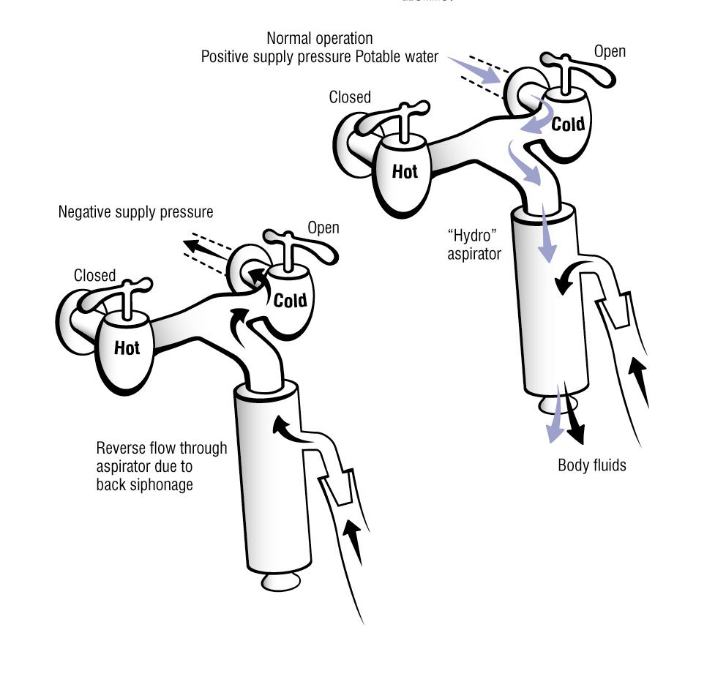
Human Blood Incident
Notes:
Hose end fertilizer/insecticide applicators
Water bed drain kits
Venturi/backsiphonage
Test Answer: The City of Portsmouth requires mortuaries to have the maximum protection from backflow.

Slide 12
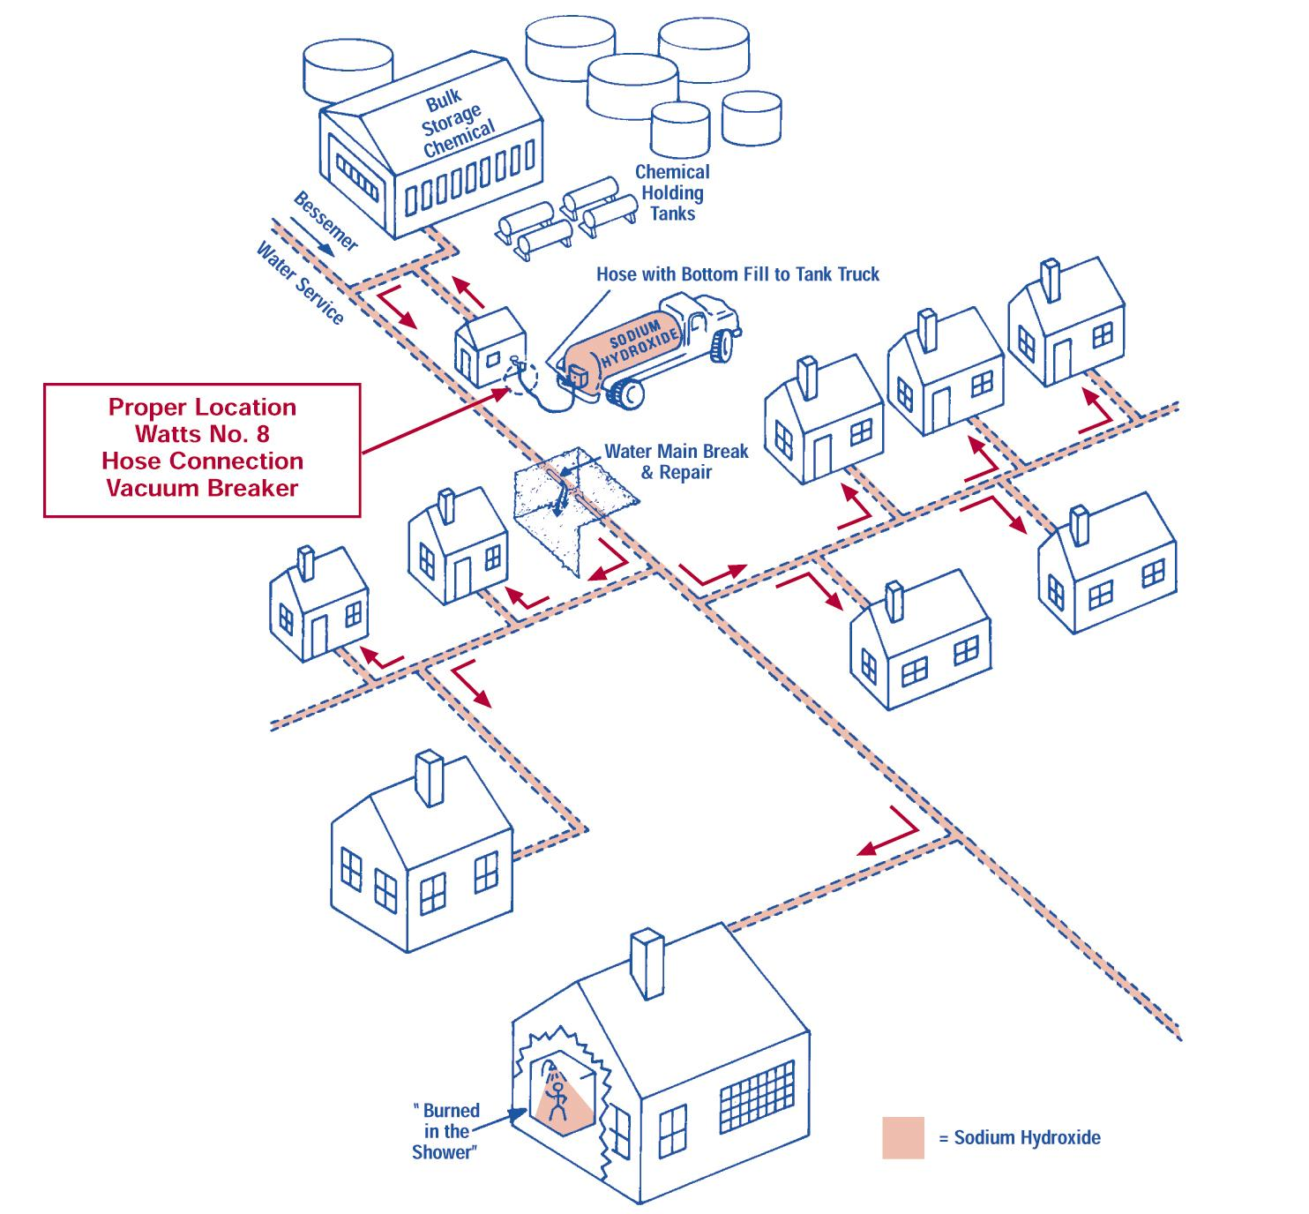
Burned in the Shower
Notes:
Severity of Sodium Hydroxide
Simple hose bibb vacuum breaker could have prevented this!!!!

Slide 13
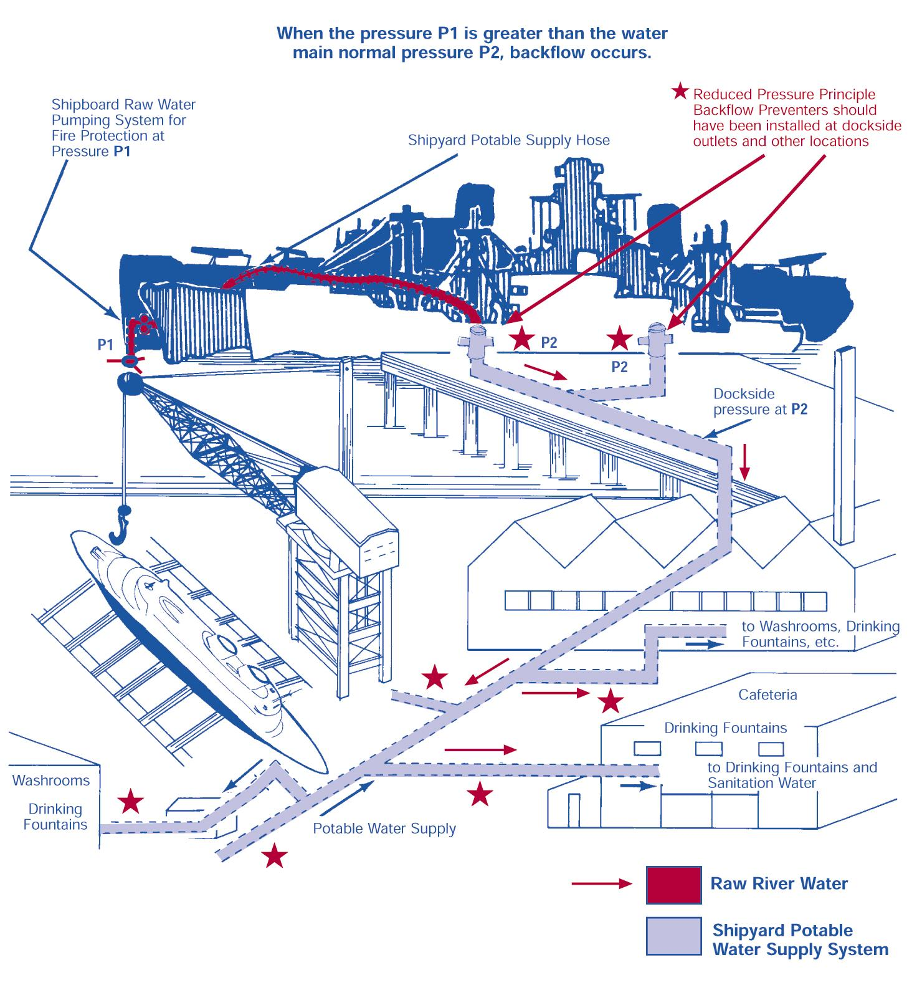
Salty Drinks
Notes:
Backpressure
Backflow device not protected from freezing
Spool piece installed
Eductor priming system on pumps

Slide 14
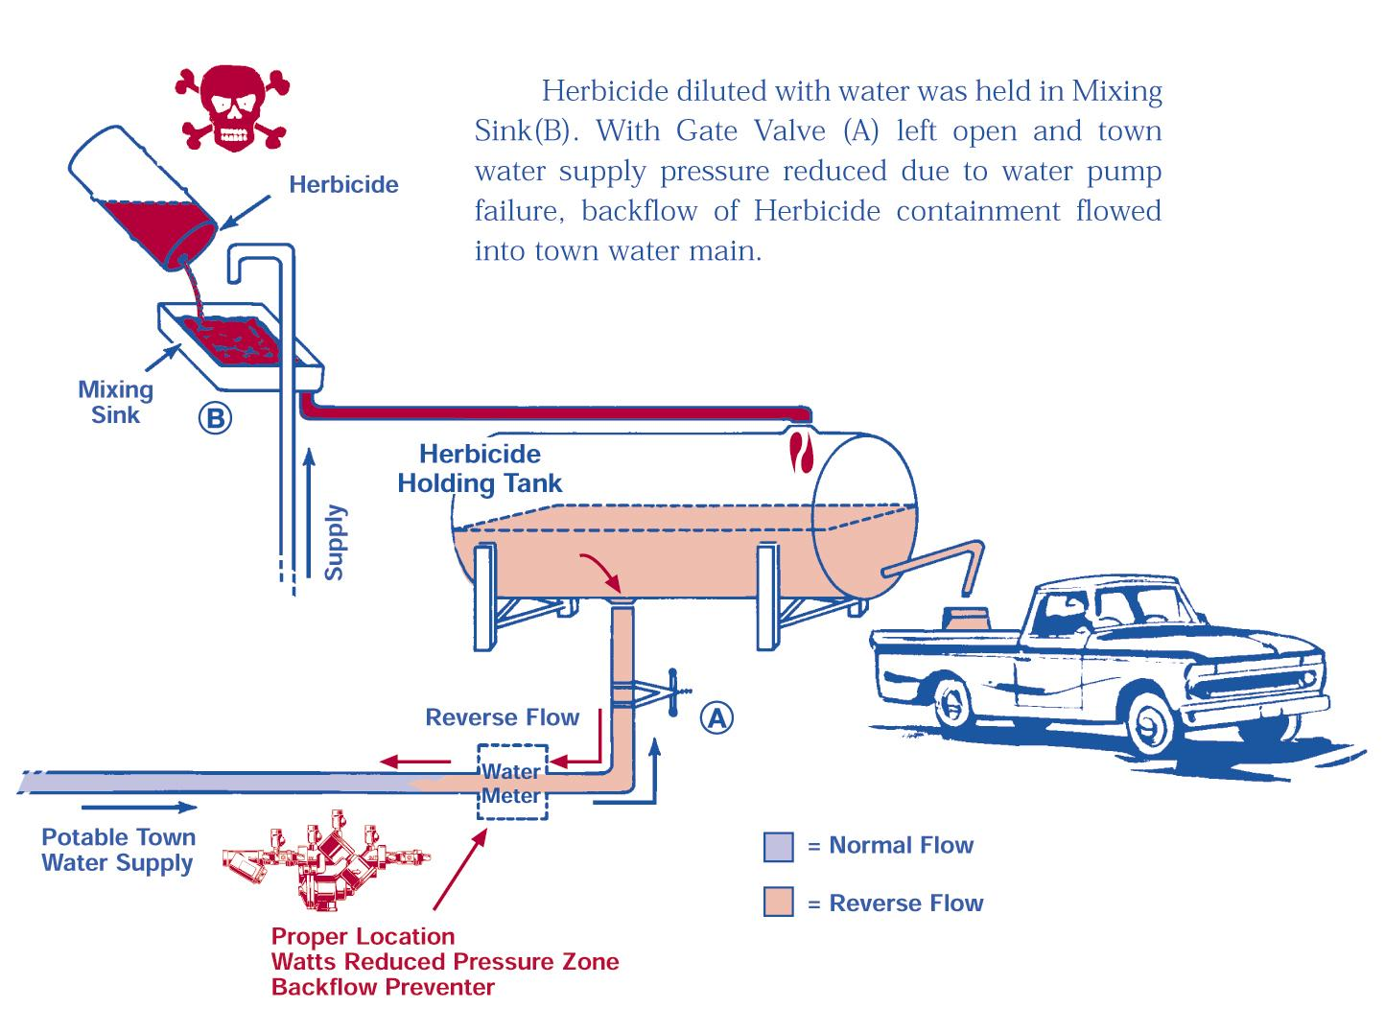
Paraquat
Notes:
Reliance on single valve
Backsiphonage
Other than RP, the potable supply should enter the top of the tank with an air gap

Slide 15
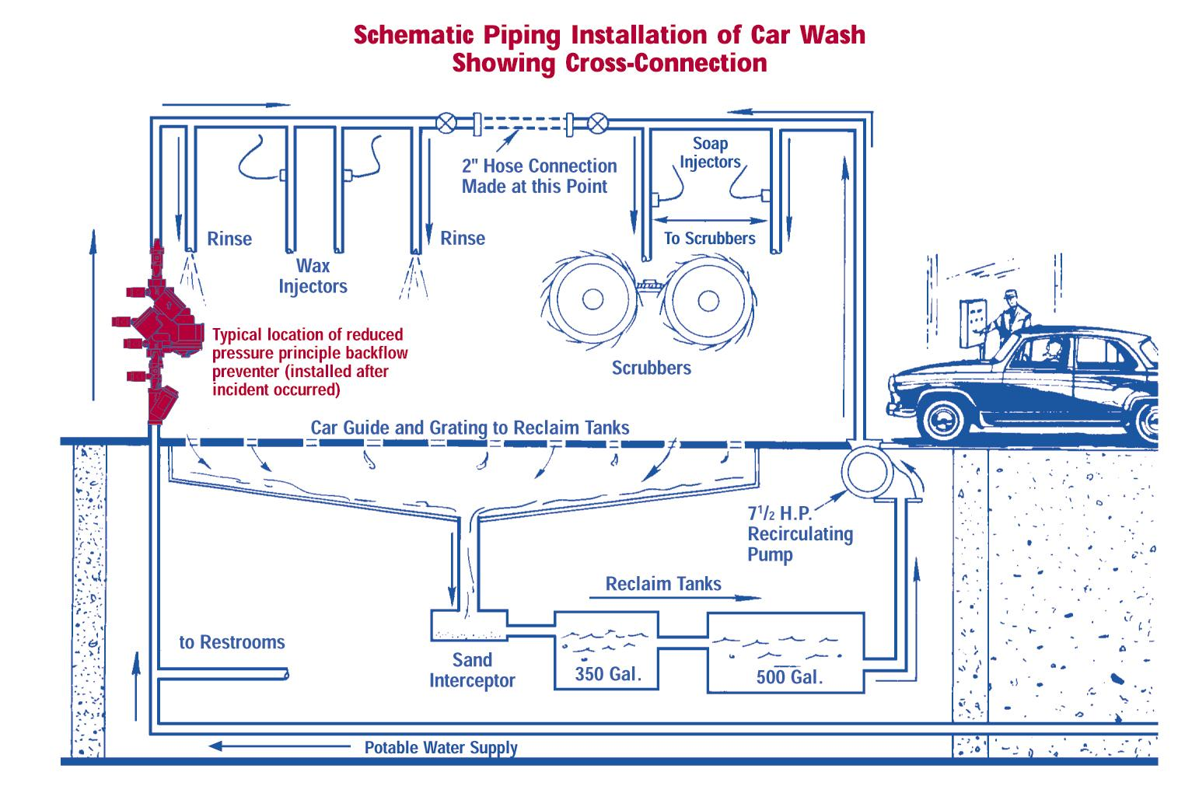
Car Wash
Notes:
Untrained personnel
Backsiphonage/backpressure
Show AWWA video tape

Slide 16
Theory of Backflow Hydraulics

Slide 17
Backflow occurs when there is a link between two systems and the resultant force is towards the potable supply

Slide 18
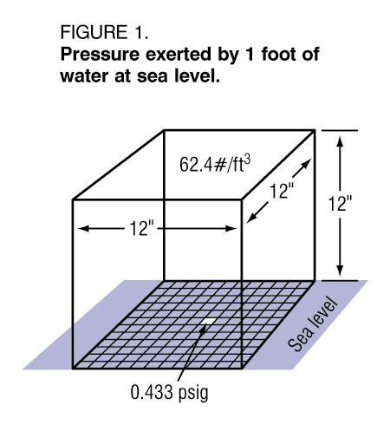
Pressure
Is a force-per-unit area such as pounds per square inch or PSI

Slide 19
Weight
Is a type of force resulting from the earth’s gravitational attraction

Slide 20
Force
Unless completely resisted, will produce motion

Slide 21
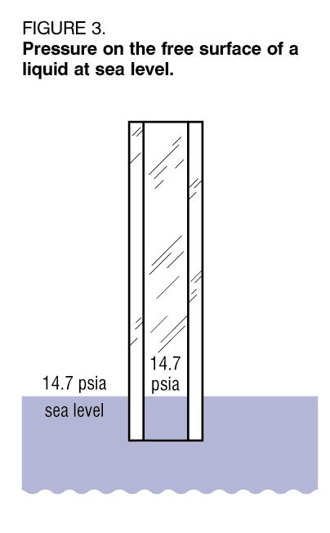
Atmospheric Pressure
Is the pressure exerted by the weight of the atmosphere above the earth

Slide 22
How is pressure expressed
Absolute scale or PSIA
Gage scale or PSIG
Pressure in absolute = P gage + 14.7 psi from atmosphere
Pressure in gage = P absolute – 14.7 psi of atmosphere
Then if gage pressure is = to 0 psi, then the absolute pressure is 14.7 psia, which is the atmospheric pressure.
Less than 0 psig would mean a “degree” of vacuum exists

Slide 23
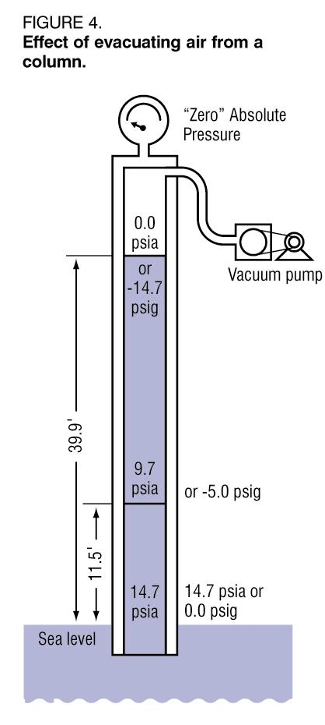
Pressure? or Vacuum?
0.0 psig = 14.7 psia
-5.0 psig = 9.7 psia
-14.7 psig = 0.0 psia

Slide 24
Water Pressure
1 psig = 2.31 feet of head (elevation)
0.433 psig = 1 foot of head 1 cubit foot of water = 62.4 lbs.

Slide 25
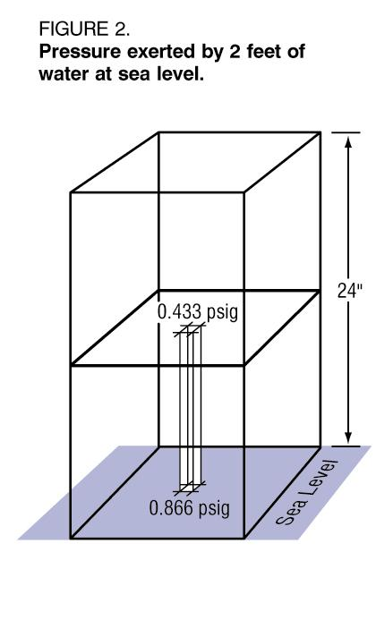
Water Pressure
0.433 psig increase for every 1 foot of head (elevation)
…so 43.3 psig = 100 feet of head

Slide 26
Backsiphonage
Results in a fluid flow in an undesirable or reverse direction
Caused by atmospheric pressure exerted on a pollutant liquid forcing it toward a potable water supply that is under any degree of vacuum

Slide 27
Siphon Theory
Atmospheric pressure acts equally on free water surface

Slide 28
Notes:
Incorrectly states 39.9’

Slide 29
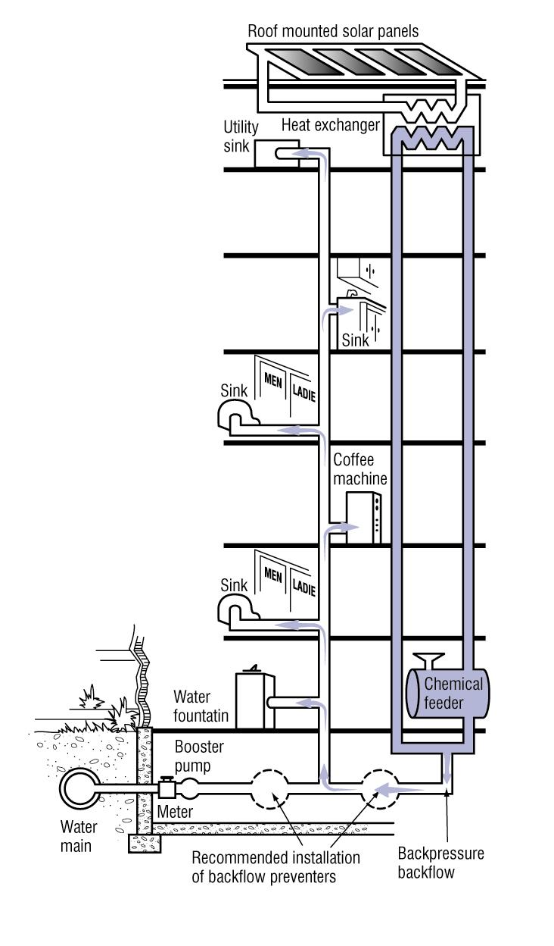
Notes:
As a practical example, let’s assume the water pressure at a closed faucet on the top of a 100 foot high building to be 20 psig: the pressure on the ground floor would then be 63.3 psig.
If the pressure at the ground were to drop suddenly due to a heavy fire demand in the area to 33.3 psig, the pressure at the top would be reduced to –10 psig.
If the building water system were airtight, the water would remain at the level of the faucet because of the partial vacuum created by the drop in pressure.
If the faucet were opened, however, the vacuum would be broken and the water level would drop to a height of 77 feet above the ground.

Slide 30
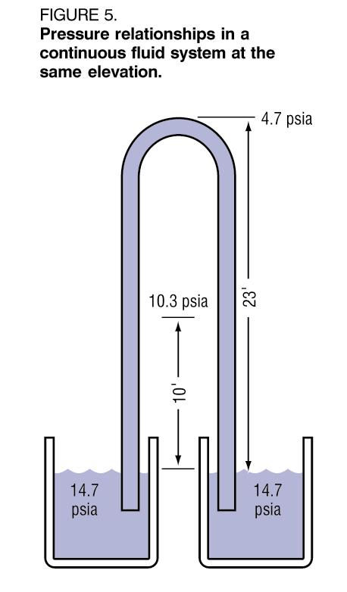
Static condition

Slide 31
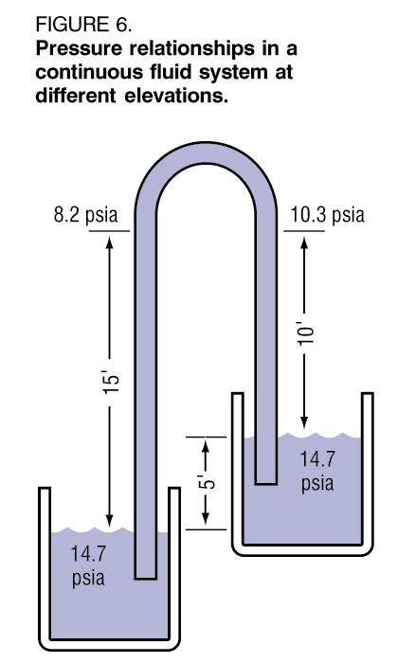
Flow/Siphon condition

Slide 32
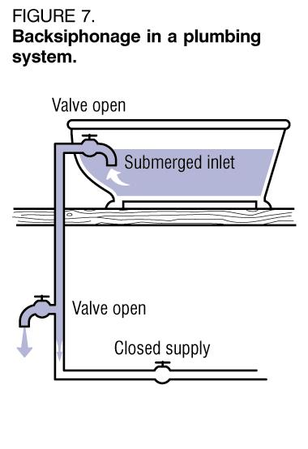

Slide 33
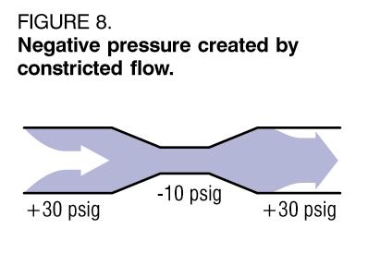
Siphon induced by fluid dynamics
When pressure increases velocity decreases
When velocity increases pressure decreases
Examples: aspirators, pipe constrictions, design flaws

Slide 34
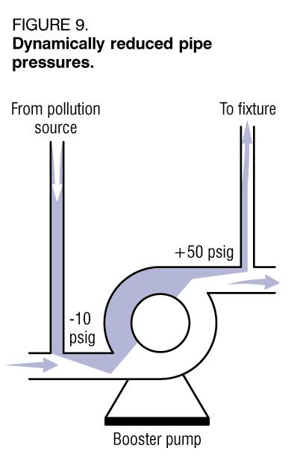
Backpressure and Backsiphonage
Notes:
The two forms of backflow are backpressure and backsiphonage.

Slide 35
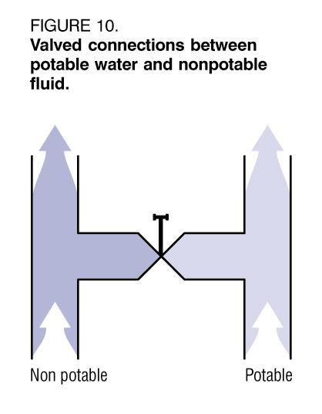
Backsiphonage Backpressure
lower pressures or vacuum higher pressures than system

Slide 36
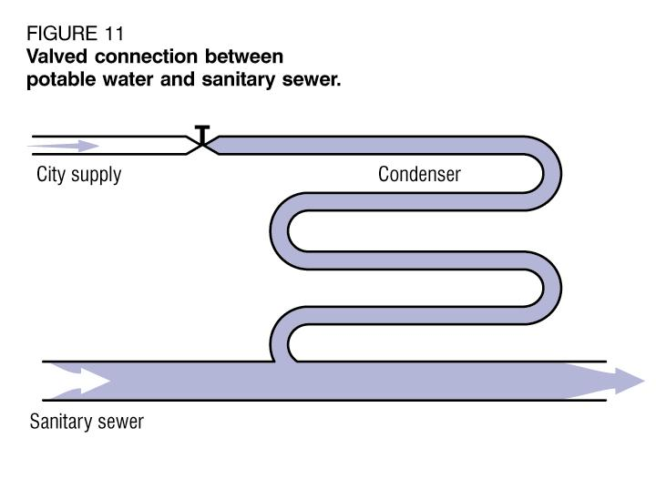
Backsiphonage Backflow
outlet submerged backpressure at outlet
Notes:
“oinker” device example

Slide 37
Backpressure/ Superior Pressure
A condition in which the pressure in a nonpotable system is greater than the pressure in the potable distribution system

Slide 38
Backpressure
Thermal Expansion
40 gallons @ 39° F
41 gallons @160° F
Incompressibility
At 7000 psi -2% volume
Pumps/ Auxiliary systems
Elevated Storage
Notes:
40 gallons is average size of water heater

Slide 39
Salty Drinks/Backpressure

Slide 40
Notes:
Superior Pressure (elevation)
Backsiphonage due to booster pump failure

Slide 41
Methods and Devices for the Prevention of Backflow and Backsiphonage
Notes:
Pass out materials
Introduce information package
Lunch at 11:45.

Slide 42
Degree of Hazards
Low degree of hazard
Moderate degree of hazard
High degree of hazard

Slide 43
Low Hazard
only degrade the quality of water aesthetically
low probability of occurrence by backsiphonage only
contaminant would not disrupt water service
health hazard would not exist
I.e..food stuff, nontoxic chemicals, non-hazardous chemicals

Slide 44
Moderate Hazard
Only degrade the quality of water aesthetically or impair its usefulness
Moderate probability of occurrence either by backpressure or backsiphonage
Contaminant would not seriously disrupt water service for drinking or domestic use
Health hazard would not exist
I.e..food stuff, nontoxic chemicals, non-hazardous chemicals

Slide 45
High Hazard
the contaminant would be toxic, poisonous, noxious or unhealthy
high probability of occurrence by backpressure or backsiphonage
contaminant would disrupt water service
health hazard would exist
I.e..sewage, toxic or hazardous chemicals, non-potable or used water, auxiliary water systems, etc…

Slide 46
Drinking Water Resources
Environmental Protection Agency Cross Connection Control Manual
Uniform Statewide Building Code (USBC)
American Society of Sanitary Engineers (ASSE)
IPC Regulations/ VA Plumbing Code
Virginia Department of Health State Waterworks Regulations (VDH)
American WaterWorks Association (AWWA)
University of Southern California Foundation for Cross Connection Control and Hydraulic Research (USC)
American Backflow Prevention Association of VA (APBA)
Notes:
Play AWWA Video, “Backflow Prevention Device Testing”, & “Backflow Prevention and Cross-Connection Control”

Slide 47
State and Local Standards
Virginia Waterworks Regulations
Uniform Statewide Building Code (USBC)
VA Plumbing Code (IPC)
______________________
Testers are licensed in Virginia according to Department of Professional Occupational Regulations (DPOR), Tradesman Regulation statute, title 54.1, Chapter 11 and can be a licensed tester through the State or by a locality
www.dpor.virginia.gov or 804.367.8511

Slide 48
Types of assemblies and devices
RPZ
DCVA
PVB
AVB
SVB
DCVIVB
BPIV
ASBC
HCVB
*Air Gap
Notes:
Air Gap is a method, not a device.
Names and designations may vary slightly between manufacturers.
Show the different types of devices on display while going through next slides.

Slide 49
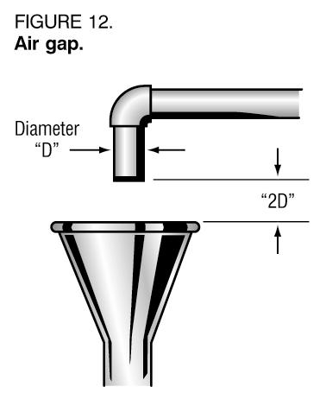
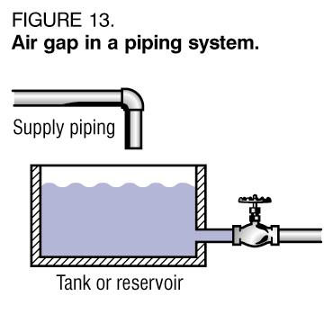
Air Gap
Very effective
Non-mechanical
Non Testable yet able to inspect
2 times ID, never less than 1 inch
Always above flood rim level, not overflow/discharge pipe
Notes:
Introduction
Test Answer: AG- a physical separation between the water outlet and the flood rim level
Test Answer: AG- the most positive/ best cross connection protection

Slide 50
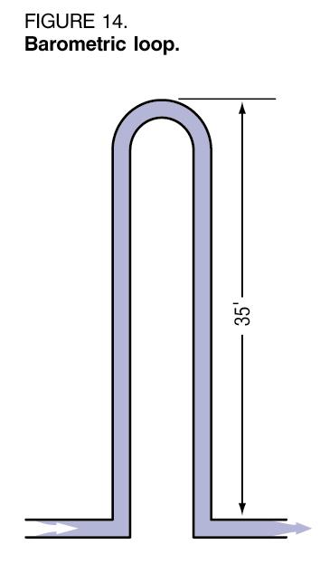
Barometric Loop
Non-mechanical
Impractical
Unpopular and not approved , but may still be out there
No protection against backpressure
Notes:
Introduction

Slide 51
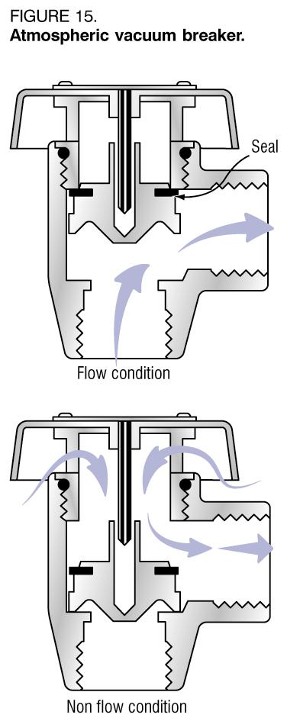
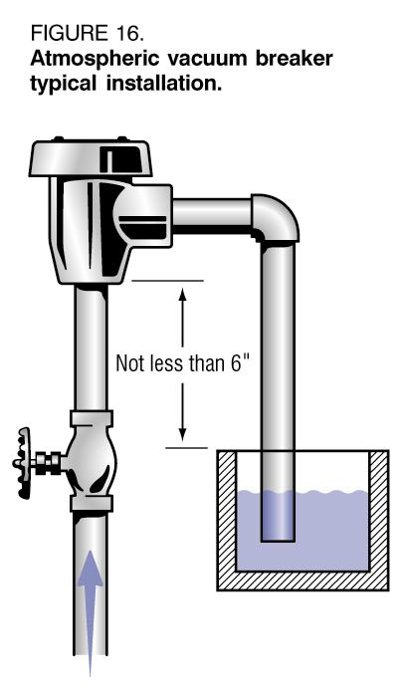
Atmospheric Vacuum Breaker
Mechanical, non-testable
Good for backsiphonage, not backpressure
No valves installed downstream of device
Minimum 6” above flood rim & vertical
Notes:
Introduction
Test answer: AVB- one float check valve and an air inlet port
Known as AVB
In service usage must be less than 12 hrs/day

Slide 52
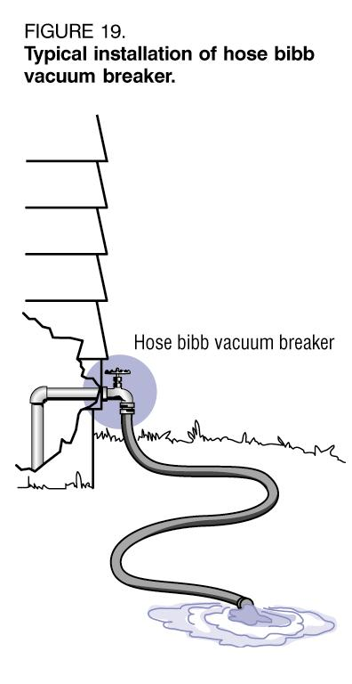
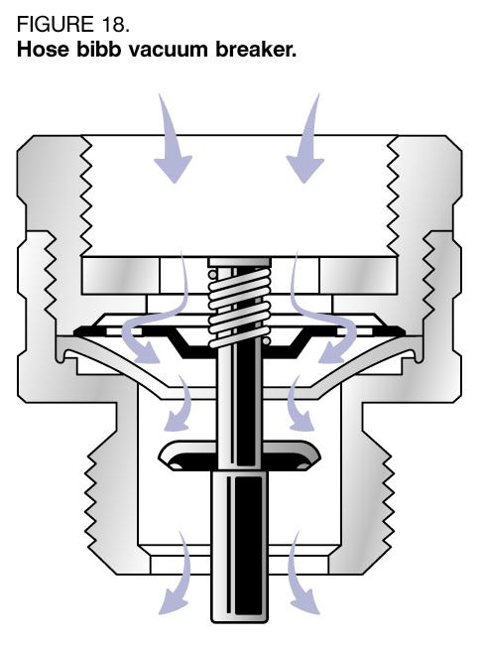
Hose Bibb Vacuum Breakers
Mechanical, non-testable
Good for backsiphonage, not backpressure
Used on garden hoses, slop sinks, spray outlets, etc…
Notes:
Introduction

Slide 53
Flushometers and Anti-Siphon Ballcocks
Must be approved device
Must be installed on all urinals and toilets
Fill valve must be 1” above overflow (ballcock type)
Flushometers installed 6” above fixture
They should never be submerged
Notes:
Introduction

Slide 54
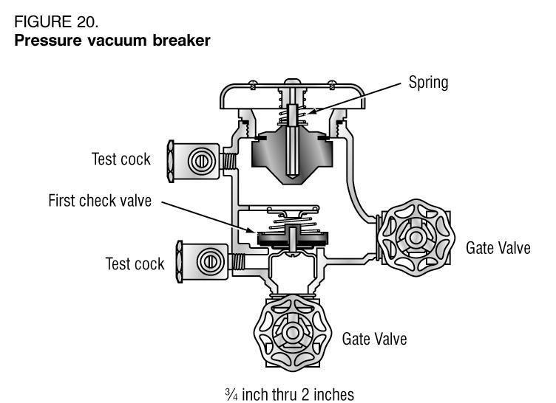
Pressure Vacuum Breakers
Testable device
Can be used under constant pressure
Good for backsiphonage, not backpressure
Installed 12” above highest outlet
Used in agriculture and irrigation
Notes:
Introduction
Book says 6 to 12” above highest outlet, it is wrong!!!!!!!!
Test answer: PVB installed 12” above highest outlet
Known as PVB

Slide 55
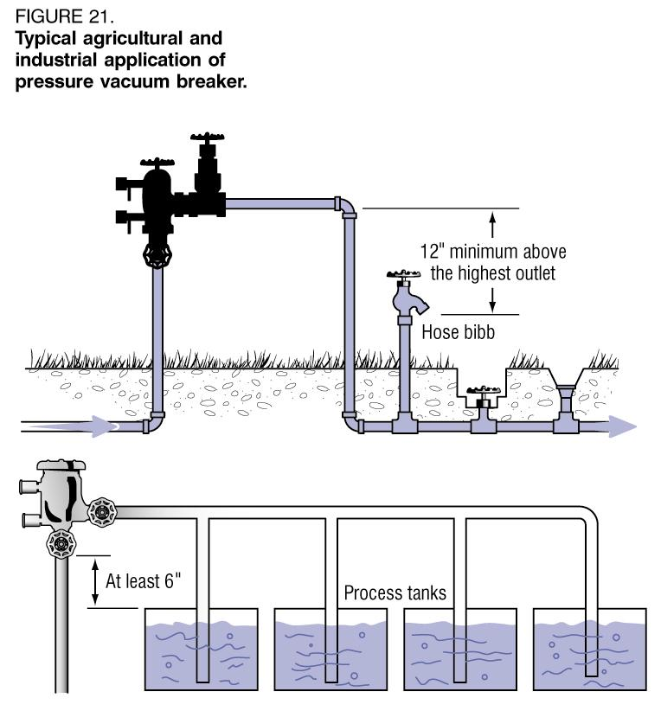
Pressure Vacuum Breakers

Slide 56
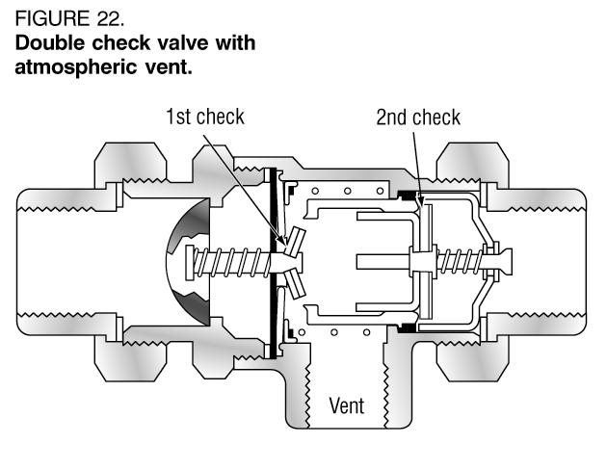
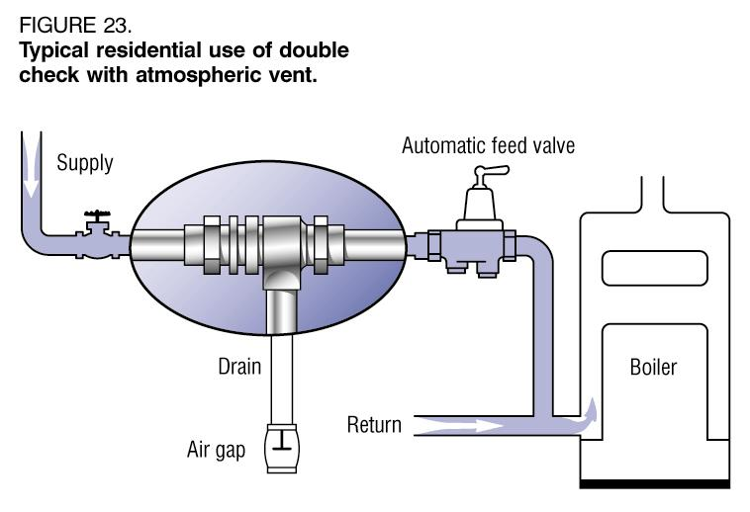
Double Check w/ Intermediate Atmospheric Vent
Non-testable
Can be used under constant pressure and will protect against backpressure
Used for moderate hazards
Common use is for residential boilers
Notes:
Introduction
Boilers conform to ASSE 1012; use no chemicals, generally residential
Industrial boilers to ASSE 1013; use an RPZ; dual hazard

Slide 57
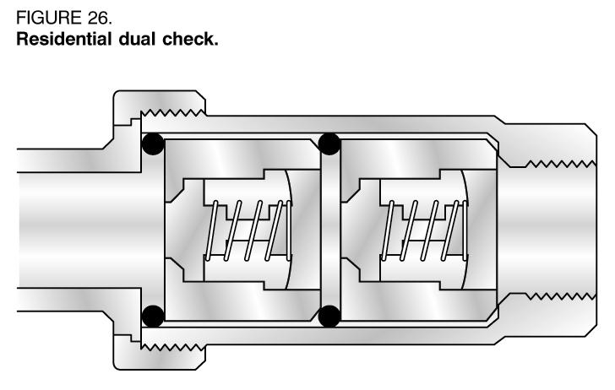
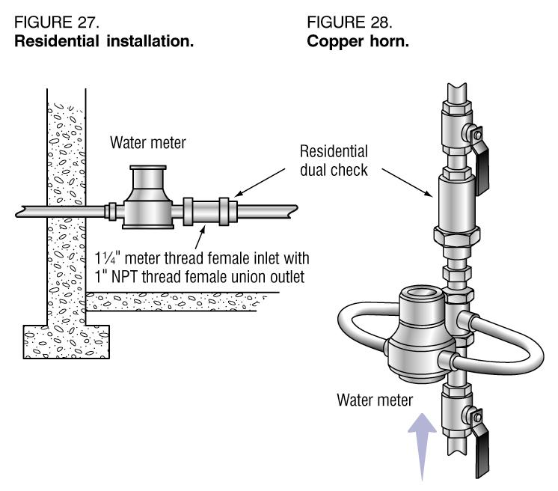
Residential Dual Check
Non-testable
Inexpensive protection against backsiphonage and backpressure
½, ¾, and 1” applications only
Notes:
Introduction

Slide 58
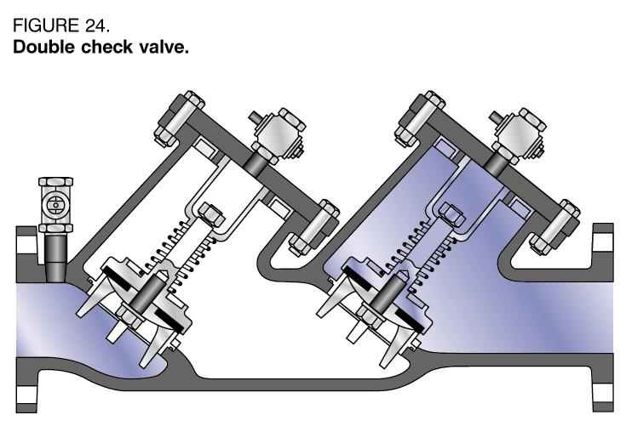
Double Check Valve Assemblies
Testable device
Effective protection against backsiphonage and backpressure
Low to moderate hazards
Used for fire protection (no chemicals), food processing, apartment complex containment
Notes:
Introduction
Test answer: there is no relief port; does not open to atmosphere
Known as DCVA

Slide 59
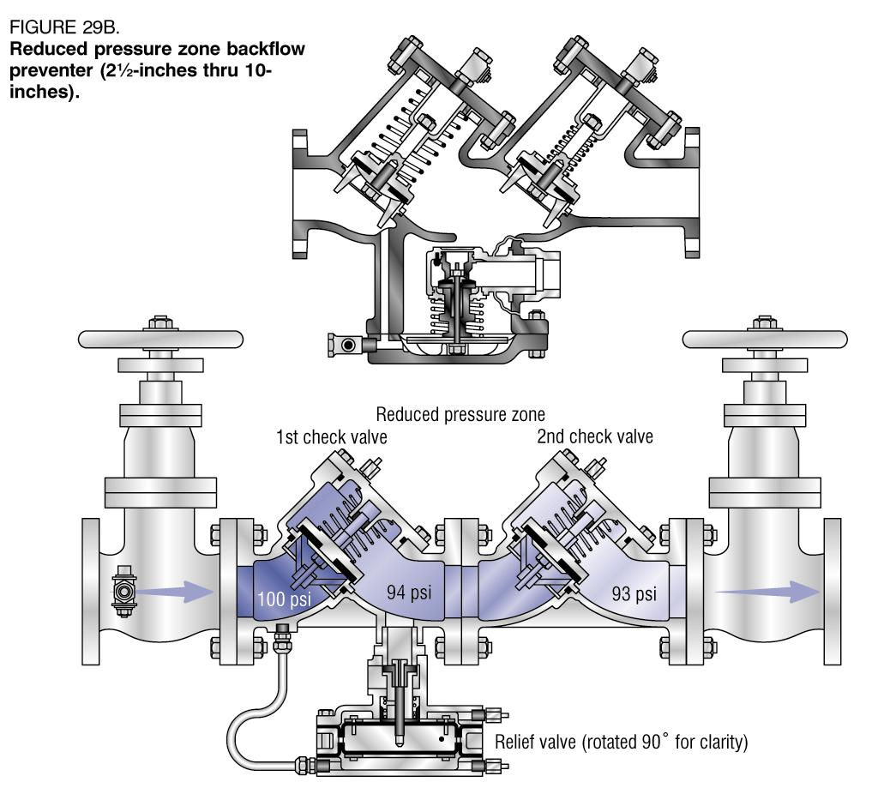
Reduced Pressure Principal Device
Testable
Maximum device protection
Double check valves with an atmospheric vent between valves
“Zone” is always kept at least 2 psi less than supply pressure
Notes:
Introduction
Known as RP or RPZ
Test Answer: minimum 12” max 48” clearance for relief port
and at least 24” on all sides for maintenance

Slide 60
Testable Devices
Pressure Vacuum Breaker (PVB)
Spill Proof (Resistance) Vacuum Breaker
Double Check Valve Assembly (DCVA, DC)
Reduced Pressure Principal Device (RPZ, RP)
Notes:
Test Answer: A backflow preventer equipped with test cocks must be inspected and tested at least once a year after the initial installation, inspection and test.

Slide 61

Identifying information found on testable devices include:
Manufacturers name
Model
Size
Serial number
Notes:
Minimum identifying information to fill out test report for a given device.

Slide 62
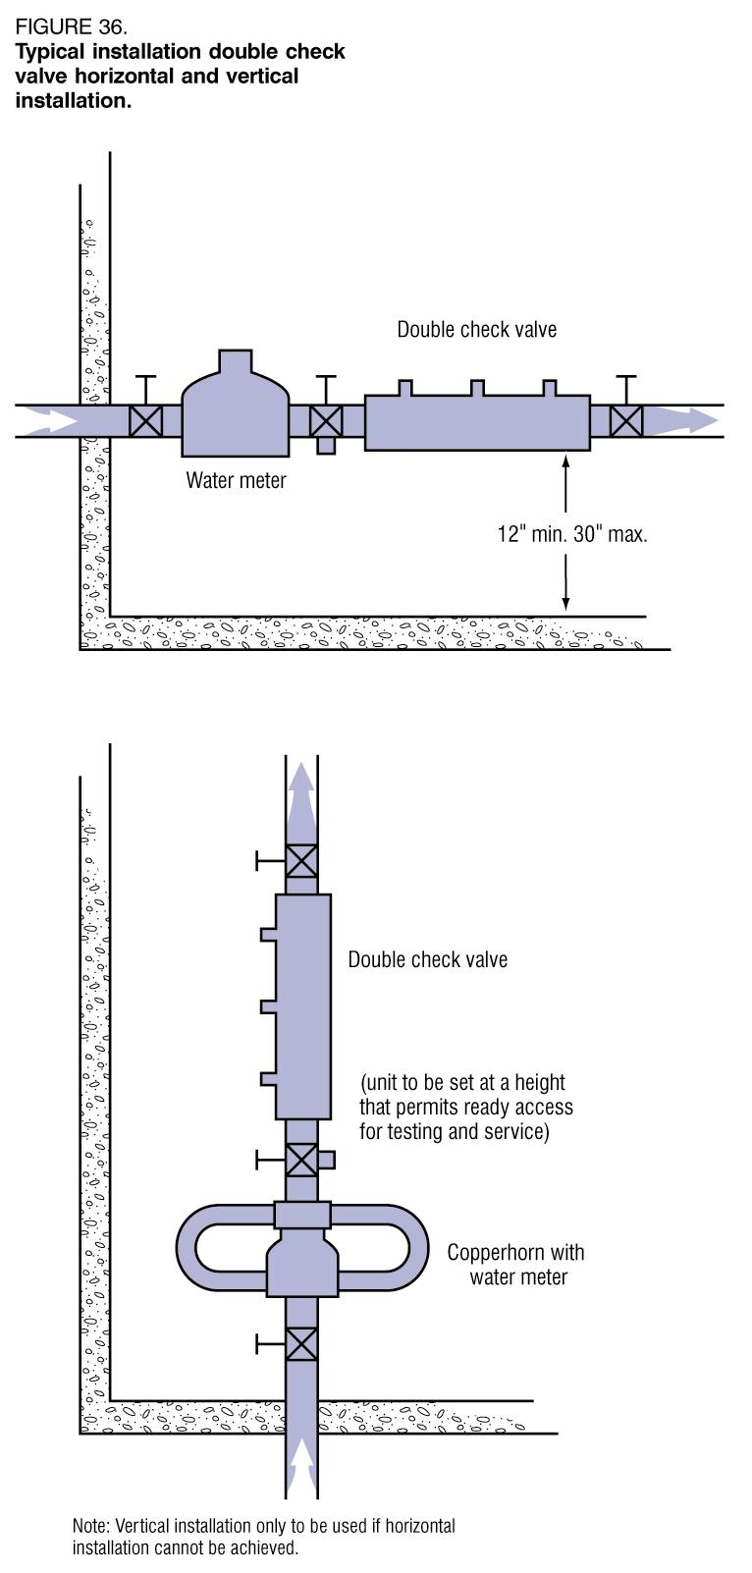
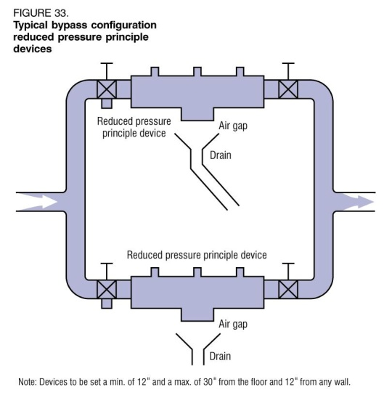
Installation
Shall be accessible
RP and DCVA shall be 12” to 30” from ground level and easily accessible for testing and maintenance
Parallel connections must both be protected if continual service is needed
Never installed in pits or areas subject to flooding

Slide 63
Installation
Always install in accordance with the manufacturers instructions.
All testable devices shall be tested at time of installation and at least annually thereafter.
Bypass lines are prohibited.
Readily accessible. Definition in IPC.
Strainer on the inlet for domestic water service.
Notes:
Show strainer

Slide 64
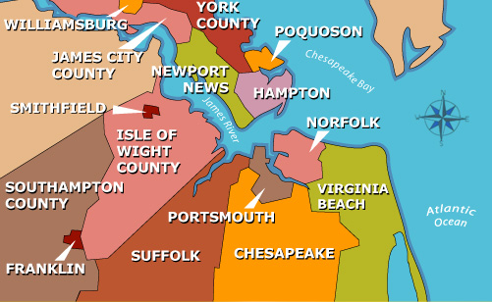
Notes:
Check with the area on their requirements

Slide 65
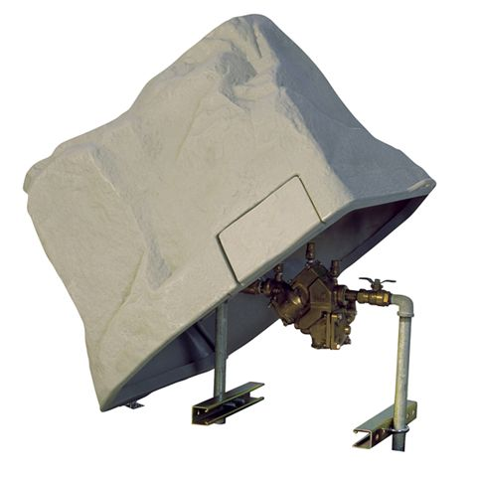
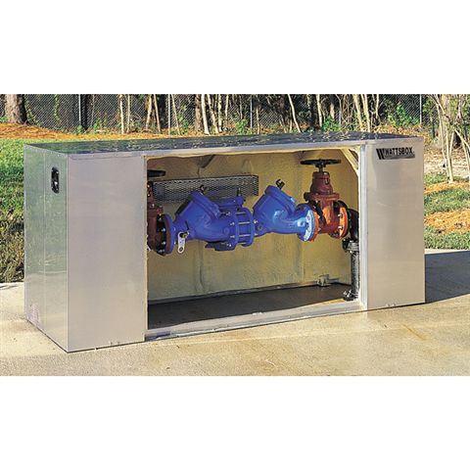

Slide 66
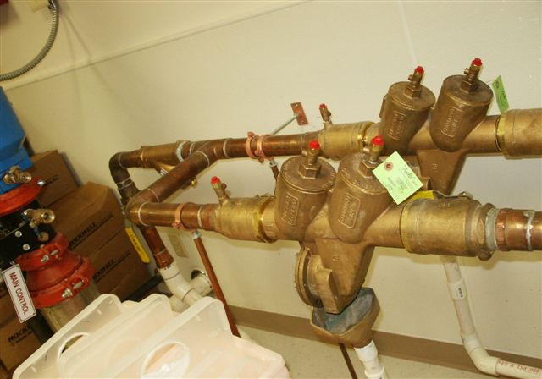
Where continuous water service is imperative, devices should be installed in parallel
Notes:
This is parallel installation, not a bypass.

Slide 67
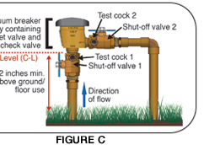

Slide 68
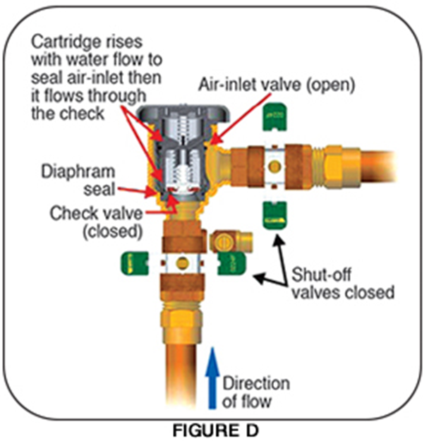

Slide 69
Pressure Vacuum Breakers
Notes:
Principal of Operation
The spring-loaded 1st check valve opens during normal flow and closes under no-flow or reversed flow conditions.
When the supply pressure drops below atmospheric pressure, the 1st check closes and the vacuum opens the air-inlet and breaks the vacuum preventing backflow from occurring.
Installation: easily accessible, 12 “ above highest downstream outlet or highest point in downstream system
downstream valve allowed

Slide 70
Double Check Valve Assemblies
Notes:
Principal of operation
1st check closes as a result of reverse flow caused by backsiphonage,
The 2nd check closes as a result of backpressure
Test Answer: The high side hose is the only hose used on a DCVA by the methods taught in this class.

Slide 71
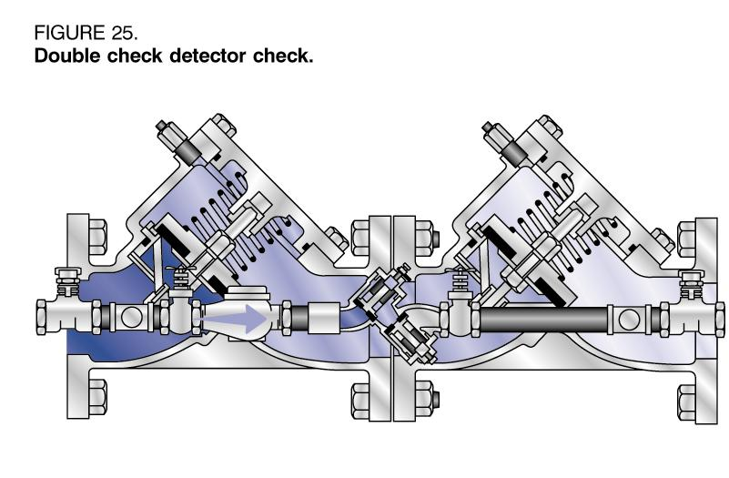
Double Check Detector Assemblies
Notes:
Principal of operation
Same as DCVA, but note the smaller bypass line with a DCVA, installed for detecting water theft, in a direct service connection fire line.

Slide 72
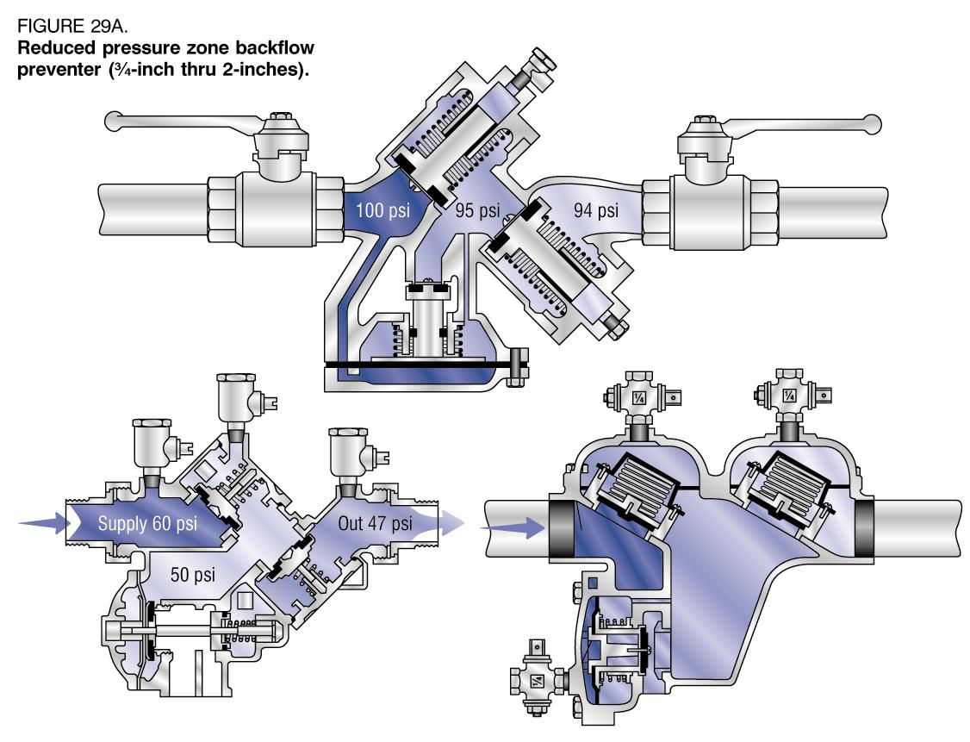
Reduced Pressure Principal
Notes:
Principal of operation
When backflow occurs, the 1st check valve will close, if the 1st check fails to seat properly, the reduced pressure zone and the 2nd check will close simultaneously.
This will open the zone to the atmosphere, dumping the backflow out the relief port.
The relief valve is sensitive to a drop of 2 psi in the supply pressure.

Slide 73
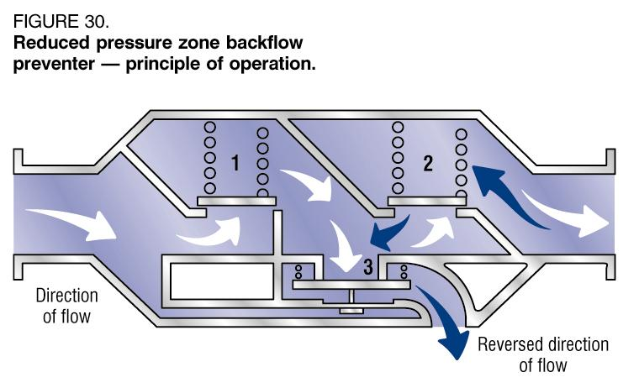
Reduced Pressure Principal
Backflow condition
Notes:
Principal of operation
When backflow occurs, the 1st check valve will close, if the 1st check fails to seat properly, the reduced pressure zone and the 2nd check will close simultaneously.
This will open the zone to the atmosphere, dumping the backflow out the relief port.
The relief valve is sensitive to a drop of 2 psi in the supply pressure.

Slide 74
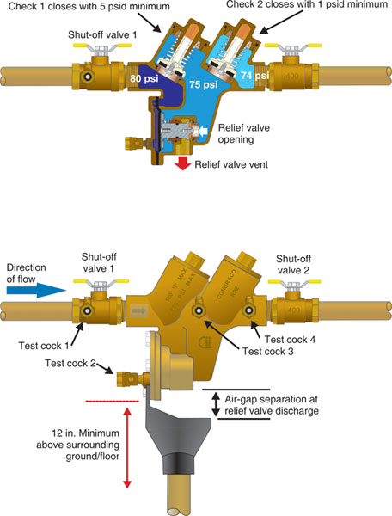

Slide 75
Yard Hydrants
Stop/waste valves are not permitted below grade IAW the IPC, however;
yard hydrants that have stand pipes that drain back into the ground are permitted if protected with a sign that reads “This water not for human consumption” and the service line is protected by a RPZ
Notes:
Point out newer type of hydrant on display table. Self contained (sanitary) hydrant is frost proof but does not drain back into the ground.

Slide 76
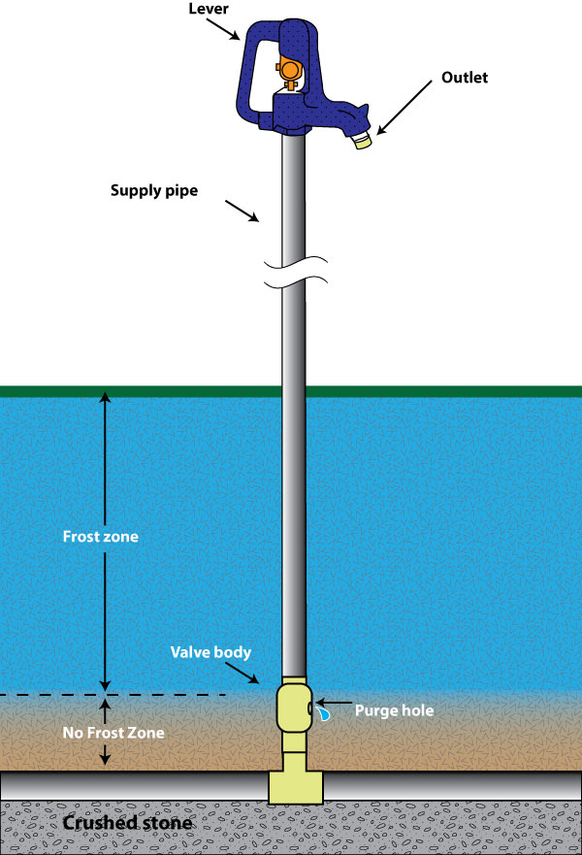

Slide 77
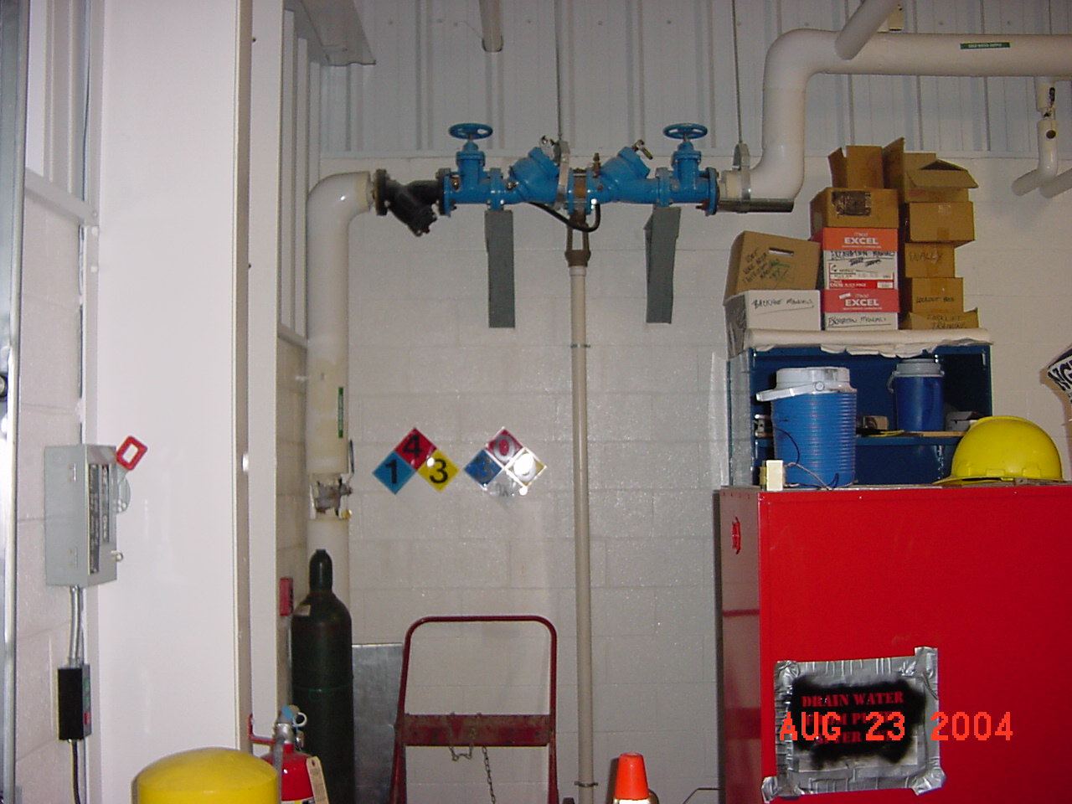
What’s wrong with this picture ?

Slide 78
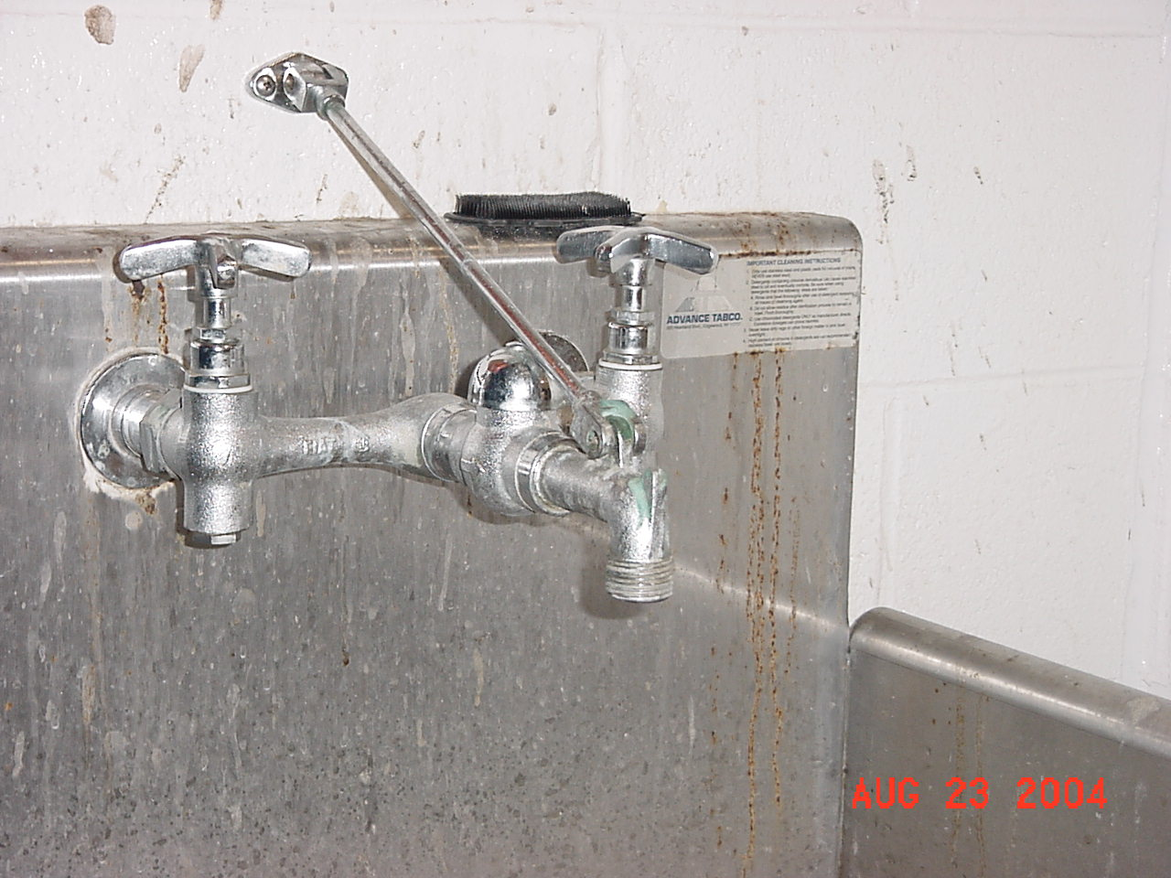
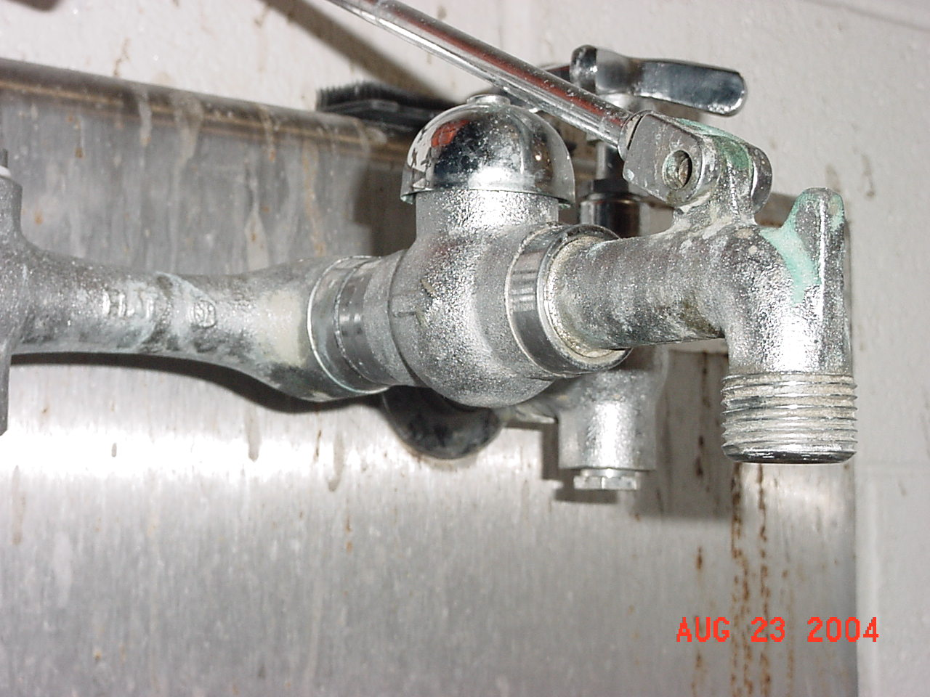
Approved Device ?

Slide 79
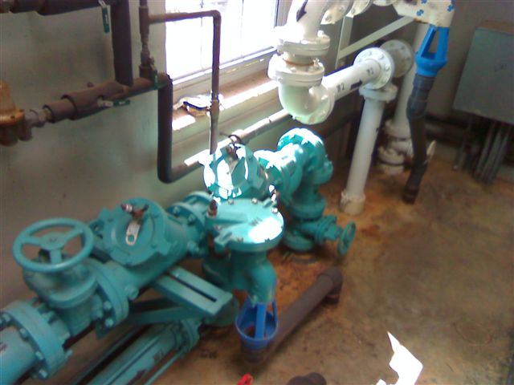

Slide 80
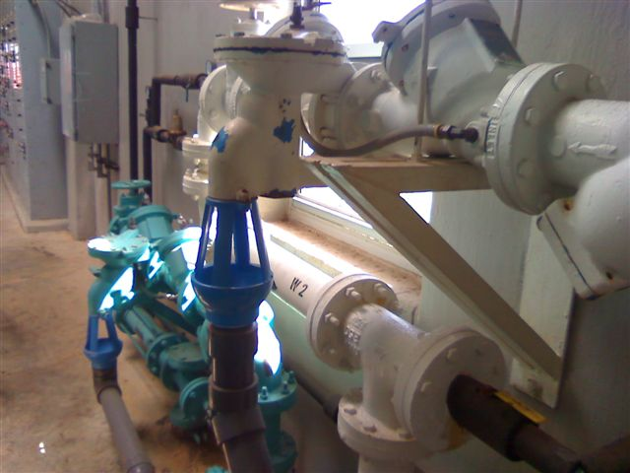

Slide 81

Approved installation?

Slide 82

Approved Hose Bibb

Slide 83

Reduced Pressure Principal

Slide 84


Approved installation?

Slide 85

Air Gap

Slide 86


Fire Service Protection

Slide 87
Systems that have a booster pump installed shall be equipped with a low pressure cut off switch on the suction side of the pump and it will be set at 10 PSI minimum.
Notes:
In accordance with the Health Department waterworks regulation.

Slide 88


