Slide 1
FY 2022 Budget Worksession I
Rec & Library Operations – Council Q&A
April 13, 2021

Slide 2

What’s Coming Up – Budget Calendar
3 Work Sessions
2 Public Hearings
Budget Adoption
April 8th 6:00 pm (Virtual) - Operating, CIP, HUD Annual Plan
April 27th 6:00 pm (Virtual) - Effective tax rate based on real estate reassessments
May 11th at 7:00pm
April 13th – Process Overview, Rec and Library Operations, Council Q & A
April 27th – VRS Overview, Council Discussion
May 4th – Reconciliation

Slide 3
What to Expect
Work Sessions
April 13th: Presentation of Rec and Library Operations followed by Council Discussion and Q & A
Council Inquiry & Response Process
Inquiries: Council makes inquiries
April 27th: – Presentation on VRS retirement options followed by Council Discussion and Q & A
May 4th: Reconciliation
Responses: Budget Office compiles running list of questions & responses
During One-on-ones with City Manager
During Budget Worksessions, or
Posted to Budget Office Website Weekly
Sent with weekly CM Update
Notes:
In FY 2019, City Council implemented a real estate tax increase – a portion of which went to fund growing backlogs in our IT infrastructure and Fleet Vehicles and Equipment.
Investment Continues
Budget allocates more than $14 million for IT and Fleet with all but $3 million supported with cash.
As the pandemic began to take hold in March of last year most office work quickly and effectively transitioned to working remotely.
Without the investment that Council made a few years prior, our reality would have been very different.
The VPN technology that the city was able to use so effectively was built using the technology funding from the FY 2019 tax increase

Slide 4
Recreation and Library Operations
April 13, 2021

Slide 5
Reopening Additional Recreation and Libraries Facilities
Time Frame for Recruitment
Health & Safety Guidelines
(as and when guided by the Health Department)
Community Expectations
Funding Availability
Factors to Consider

Slide 6
Library Operations

Slide 7
Where We Were - Pre-Covid
Facility | Hours per Week
Mary D. Pretlow Anchor Branch | 7 Days per week – 62 hours
Jordan-Newby Anchor Branch | 7 Days per week – 62 hours
Neighborhood Branches (9) Barron F. Black, Blyden, Horace C. Downing, Janaf, Lafayette, Larchmont, Little Creek, Park Place, and Van Wyck | 6 Days per week – 50 hours
Total Service Hours | 574 Hours/Wk
Services Offered
Check outs and browsing
Programming – Early Literacy; Summer Reading; Summer Food; Read 1,000 Books Before Kindergarten; Adult Collaboration
Bookmobile – full service/full schedule
Computer usage
Meeting and collaborative study rooms
Creative spaces – Playscapes, Kid Zones, and Art Studio

Slide 8
Where We Are
Facility | Hours per Week
Mary D. Pretlow Anchor Branch | 5 Days per week – 40 hours
Jordan-Newby Anchor Branch | 5 Days per week – 40 hours
Neighborhood Branches (3) Barron F. Black, Park Place, Van Wyck | 2 Days per week – 18 hours
Total Service Hours | 134 Hours/Wk
Services Offered
Grab and Go checkouts
Sergeant Memorial Collection (SMC) – Research via phone five days a week
Virtual Program – Six days a week
Mobile Delivery – Five days a week
Senior Centers, Neighborhoods, NRHA, and Military Stops
Express Book Nooks at four recreation centers

Slide 9
Circulation During the Pandemic COVID-19 Changed How Residents Used Libraries
Circulation By the Numbers
Circulation | Jan – Dec 2019 | Apr 2020 - Mar 2021
Total | 680,714 | 282,500
eResources | 117,282 | 138,428
Percent eResources | 17.23% | 49.00%
Total circulation down by 58 percent
e-Circulation up by 18 percent
e-Circulation as percent of total up from 17 percent to 49 percent of total

Slide 10
Budget Comparison - Libraries
Pre-COVID Budget
$9,789,885
Current Budget
$7,581,153
Proposed Budget
$8,530,307
(Annualized)
Position Summary
Description | Count
Permanent | 98.5
Part-time Funding | $1M
Position Summary
Description | Count
Permanent | 76
Part-time Funding | $0
Position Summary
Description | Count
Permanent | 95
Part-time Funding | $0
Proposed Budget includes funding for Tucker Memorial Library
Primary resource constraint for NPL is lack of PT staff in Proposed Budget
Allowing NPL to flex personnel funding between Permanent and PT staff will result in restoration of greatest number of service hours

Slide 11
Where We Are Headed
Facility | Hours per Week
Mary D. Pretlow Anchor Branch | 6 Days per week – 48 hours
Jordan-Newby Anchor Branch | 6 Days per week – 48 hours
Richard Tucker Anchor Branch | 6 Days per week – 48 hours
Neighborhood Branches (7) Barron F. Black, Blyden, Janaf, Lafayette, Larchmont, Little Creek, and Van Wyck | 5 Days per week – 40 hours
Total Service Hours | 424 Hours/Wk
Services Offered
Check outs and browsing
Programming – Early Literacy; Summer Reading; Summer Food; Read 1,000 Books Before Kindergarten; Adult Collaboration
Bookmobile – full service/full schedule
Computer usage
Meeting and collaborative study rooms
Creative spaces – Playscapes, Kid Zones, and Art Studio

Slide 12
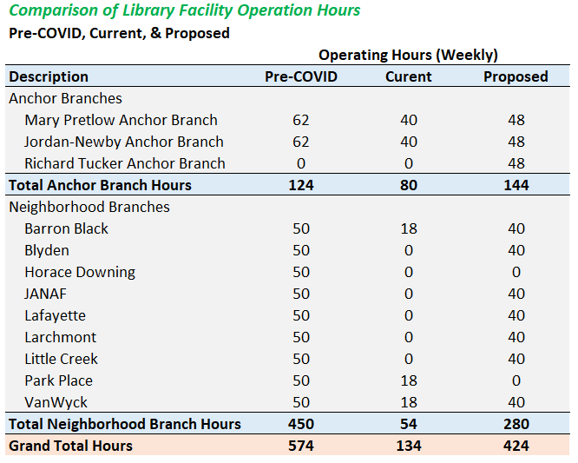
Comparison

Slide 13
Recreation Operations

Slide 14
Overview
Athletics:
Normal operations have or will resume
Aquatics
Three Public Beaches and three Indoor Pools (Northside, Huntersville, Southside Aquatic) will all be open and operate under slightly reduced hours
Norfolk Public Schools
Will continue to use attached gym facilities for PE classes and indoor pools for swim team practices
Recently signed MOU has formalized longstanding process
Will not impact city’s ability to operate facilities as done pre-COVID

Slide 15
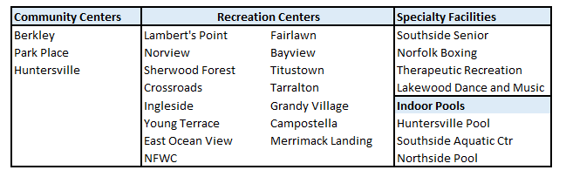
Where We Were - Pre-Covid
Facility | Hours per Week
Community Centers (3) | 86.5 Hours/Wk
Recreation Centers (15) | 652 Hours/Wk
Specialty Facilities (4) | 172 Hours/Wk
Indoor Pools (3) | 192 Hours/Wk
Total Service Hours | 1,102 Hours/Wk

Slide 16
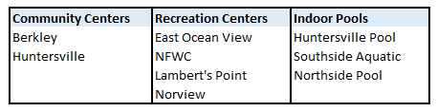
Where We Are
Facility | Hours per Week
Community Centers (2) | 90 Hours/Wk
Recreation Centers (4) | 180 Hours/Wk
Standalone Pools (3) | 135 Hours/Wk
Total Service Hours | 405 Hours/Wk

Slide 17
Budget Comparison - Recreation
Pre-COVID Budget
$5.65M
Current Budget
$2.6M
Proposed Budget
$4.1M
(Annualized)
Position Summary
Description | Count
Permanent | 60
Part-time Funding | $2.1M
Position Summary
Description | Count
Permanent | 28
Part-time Funding | $0
Position Summary
Description | Count
Permanent | 44
Part-time Funding | $1.1M
Proposed Budget includes funding for summer youth programming
Primary resource constraint for RPOS is reduction in funding for part-time staff in Proposed Budget
Allowing RPOS to flex personnel funding between Permanent and PT staff will result in restoration of greatest number of service hours

Slide 18
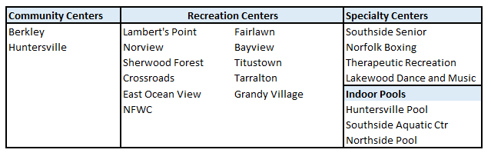
Where We Are Headed
Facility | Hours per Week
Community Centers (2) | 62 Hours/Wk
Recreation Centers (11) | 453.5 Hours/Wk
Specialty Centers (4) | 150 Hours/Wk
Indoor Pools (3) | 135 Hours/Wk
Total Service Hours | 801 Hours/Wk
Notes:
Open 45 hrs/wk or pre-Covid Hours – which ever is higher
Results in reduced hours for: NFWC, Norview, Lambert’s Point, East OV, Boxing Center
Facilities not opened: Park Place, Ingleside, Young Terrace, Merrimack, Compostella, Captain’s Quarters (seasonal), NFWC outdoor Pool (Seasonal)
Vivian Mason – rented to TWP, no RPOS staffing

Slide 19
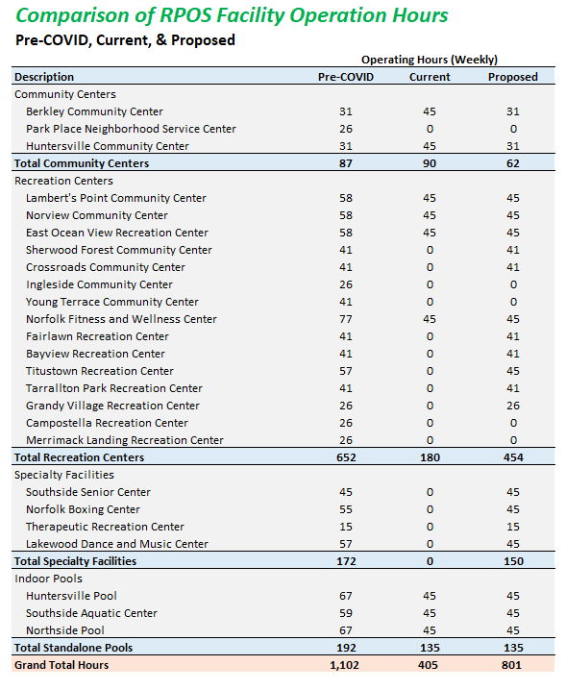

Slide 20
Discussion

